Slide 2
Absence of Copyright
This slideshow contains photos, diagrams, and information, some of which were attained through internet searches of public websites. The author of this presentation does not own the copyright on this information, so this slideshow is for personal use only—not for sale or profit. Please utilize it to seek the Lord and grow in your knowledge of His Word and ways.
Bro Stan’s Revelation Study is available on our church website:
www.faithprinceton.org

Slide 4
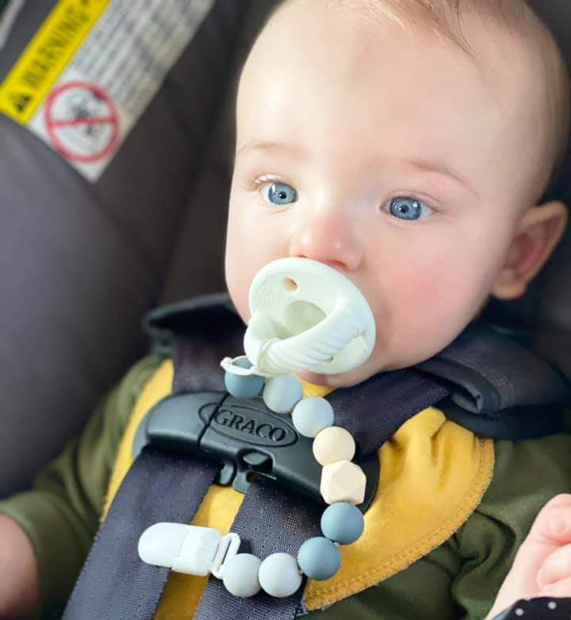
Noah...
Strapped in and wondering where our study will take us tonight...

Slide 5
Prayer and Announcements
Sunday:
9:15 Small Group Sunday School Classes
(Kids class and nursery as well)
10:30 Worship

Slide 7
END HERE SEPTEMBER 30, 2020
LAST WEEK 20 Revelation 13 b
The False Prophet and the Mark of the Beast
THIS WEEK 21 Revelation 14

Slide 8
Revelation 14
V 1-5 The Lamb and 144,000
V 6-10 Three Angels
V 14-20 Two Reapings
V 14-16 The Hour to Reap Souls
V 17-20 The Grapes of Wrath
Notes:
After the dismal outlook of chapter 13 with the rise of the AntiChrist and False Prophet,
We are reminded in chapter 14 about the ultimate victor standing on Mount Zion and orchestrating the end...
V 1-2 The Lamb and 144,000
V 3 A New Song
V 4-5 First fruits to God
V 6-10 three Angels
V 6-7 1st Angel with eternal gospel to preach
V 8 2nd angel announces fall of Babylon
V 9-10 3rd Angel cup of wine of wrath of God
V 11-12 Torment or perseverance
V 13 Rest from labors
V 14-20 two reapings
V 14-16 The Hour to Reap
V 17-20 The Grapes of Wrath

Slide 9
Revelation 14:1-2 The Lamb and 144,000
1 Then I looked, and behold, the Lamb was standing on Mount Zion, and with Him one hundred and forty-four thousand, having His name and the name of His Father written on their foreheads. 2 And I heard a voice from heaven, like the sound of many waters and like the sound of loud thunder, and the voice which I heard was like the sound of harpists playing on their harps.
Notes:
Lamb standing on Mount Zion = place of Davidic kingdom and power; temple
144,000 = Revelation 7:4 And I heard the number of those who were sealed, one hundred and forty-four thousand sealed from every tribe of the sons of Israel...
Written on their foreheads = His Name instead of the Mark of the Beast (Rev 13 !!) showing they belong to Jesus and God the Father not the Beast
Voice = LIKE the sound of many waters... Loud thunder... HARPS (musical???)

Slide 10
Revelation 14:1-2 Who are the 144,000?
Pre-Trib: Israelites converted after the Rapture of the Church at the beginning of the Tribulation
Symbolic: Complete number representing all of the faithful, redeemed of God
Agreement: Number is symbolic representing completeness of God’s people... All of whom are preserved! (compare Rev 7:4 with Rev 14:1)
Notes:
Lamb standing on Mount Zion = place of Davidic kingdom and power; temple
144,000 = Revelation 7:4 And I heard the number of those who were sealed, one hundred and forty-four thousand sealed from every tribe of the sons of Israel... (in v 9 John sees: a great multitude which no one could count, from every nation and all tribes and people and tongues, standing before the throne and before the Lamb...)
Newport, Lion and the Lamb, 249
The number is symbolic of the vast and complete number of God’s people. It refers to all of the redeemed of God—those who have been faithful to Christ through their trials and testings.
Epp
Number refers to Israelites saved at the beginning of the Tribulation after the rapture of the church
Agreement: a symbolic number representing perfect wholeness of 12 x 12 = 144
Written on their foreheads = His Name instead of the Mark of the Beast showing they belong to Jesus and God the Father not the Beast
Voice = many waters... Loud thunder... HARPS (musical???)

Slide 11
Revelation 14:3 A New Song
3 And they *sang a new song before the throne and before the four living creatures and the elders; and no one could learn the song except the one hundred and forty-four thousand who had been purchased from the earth.
Notes:
New song = Rev 5:9 And they *sang a new song, saying,
“Worthy are You to take the book and to break its seals; for You were slain, and purchased for God with Your blood men from every tribe and tongue and people and nation.
no one could learn the song
144,000 who had been purchased from the earth = ??? By the blood of the lamb!!!

Slide 12
Revelation 14:4-5 First fruits to God
4 These are the ones who have not been defiled with women, for they have kept themselves chaste. These are the ones who follow the Lamb wherever He goes. These have been purchased from among men as first fruits to God and to the Lamb. 5 And no lie was found in their mouth; they are blameless.
Notes:
Not been defiled with women ??? to pollute, stain, contaminate, defile; used of "moral soil (smut)" that defouls and besmirches the soul
= as opposed to the immorality of idolatry
Chaste... Pure NIV virgins ➔ (παρθένος) 1 usually of a female who has not had relations; 2. "a man who has abstained from all uncleanness and whoredom attendant on idolatry, and so has kept his chastity":
follow the Lamb wherever He goes = obedient to His Lordship
Purchased
First fruits = more to follow!
No lie... Blameless... = the spotless bride of Christ

Slide 13
Revelation 14:6-7 An Eternal Gospel to Preach
FIRST ANGEL:
6 And I saw another angel flying in midheaven, having an eternal gospel to preach to those who live on the earth, and to every nation and tribe and tongue and people; 7 and he said with a loud voice, “Fear God, and give Him glory, because the hour of His judgment has come; worship Him who made the heaven and the earth and sea and springs of waters.”
Notes:
First of three angels...
having an eternal gospel to preach to those who live on the earth == announced in a LOUD voice... Still not too late to repent!!! Mercy is always available before final judgment!
to every nation and tribe and tongue and people
Fear God, and give Him glory, because the hour of His judgment has come;
worship Him who made the heaven and the earth and sea and springs of waters.”
The HOUR of His Judgment has come!!!

Slide 14
Revelation 14:8 Fall of Babylon
SECOND ANGEL:
8 And another angel, a second one, followed, saying, “Fallen, fallen is Babylon the great, she who has made all the nations drink of the wine of the passion of her immorality.”
Notes:
Fallen is Babylon the great
The greatest of nations will fall because of immorality
1 Peter 5:12-13 allusion to Rome
All the nations...

Slide 15
Revelation 14:9-10 Wrath of God
THIRD ANGEL:
9 Then another angel, a third one, followed them, saying with a loud voice, “If anyone worships the beast and his image, and receives a mark on his forehead or on his hand, 10 he also will drink of the, wine of the wrath of God which is mixed in full strength in the cup of His anger; and he will be tormented with fire and brimstone in the presence of the holy angels and in the presence of the Lamb.
Notes:
Wine of the wrath of God mixed in full strength in the cup of His anger ➔ unmixed, undiluted
Cup of God’s wrath ➔ Jer 25:15; Job 21:20; Ps 75:8; Isa 51:17
Tormented ... In the presence of the holy angels and in the presence of the Lamb????
Angels?
Lamb = because they rejected His sacrificial love for them...
Hebrews 10 trampled under foot the Son of God and insulted the Spirit of Grace

Slide 16
Revelation 14:11-12 Torment or Perseverance
11 And the smoke of their torment goes up forever and ever; they have no rest day and night, those who worship the beast and his image, and whoever receives the mark of his name.” 12 Here is the perseverance of the saints who keep the commandments of God and their faith in Jesus.
Notes:
TWO ULTIMATE FATES OF MANKIND:
TORMENT FOREVER =
Newport, Lion and the Lamb, 253
C.S. Lewis (see Problem of Pain) acknowledges that hell is a detestable doctrine that he would be willing to remove from Christianity if it were in his power. Ut Lewis states that the question is not whether it is detestable but whether it is true. We must recognize that the reality of hell has the full support of Scripture and of Christ’s teaching. Indeed, it has always been held by evangelical Christians and has the support of reason.
Leon Morris, Tyndale
12. A consideration of ultimate realities sustains the people of God. They must pass through troubles, but they know that their troubles are temporary whereas those of their tormentors will be eternal. This sense of values keeps them calm. It issues in steadfastness...

Slide 17
Revelation 14:11-12 (cont) Perseverance
12 Here is the perseverance of the saints who keep the commandments of God and their faith in Jesus.
perseverance of the saints
keep the commandments of God
keep their faith in Jesus
Notes:
Leon Morris, Tyndale
The saints are characterized by their obedience to God’s commandment and their faithfulness to Jesus.
Both ethical conduct and reliance on the Saviour are important.
PERSEVERANCE OF THE SAINTS: Hang in there!!!!!!!!!!
Keep the commandments of God = LOYAL to His LORDSHIP
Keep their faith in Jesus = TRUST in His WORD

Slide 18
Revelation 14:13 Rest from Labors
13 And I heard a voice from heaven, saying, “Write,
‘Blessed are the dead who die in the Lord from now on!’”
“Yes,” says the Spirit, “so that they may rest from their labors, for their deeds follow with them.”
Notes:
Beatitude: Blessed are...
Matthew 5:11-12 ¹¹ “Blessed are you when people insult you and persecute you, and falsely say all kinds of evil against you because of Me. ¹² Rejoice and be glad, for your reward in heaven is great; for in the same way they persecuted the prophets who were before you.
Rest from their labors
Contrast the beast worshippers: 11 And the smoke of their torment goes up forever and ever; they have no rest day and night, those who worship the beast and his image, and whoever receives the mark of his name.”
Labors = κόπος = : (a) trouble, (b) toil, labor, laborious toil, involving weariness and fatigue. (from 2875 /kóptō, "to hit, strike") – properly, a strike (blow) that is so hard, it seriously weakens or debilitates; (figuratively) deep fatigue, extreme weariness (wearisome toil).
“work” that is a “beat-down” !!!
For their deeds follow with them

Slide 19
END HERE OCTOBER 7, 2020
LAST WEEK 20 Revelation 13 b
The False Prophet and the Mark of the Beast
THIS WEEK 21 Revelation 14

Slide 20
Two Reapings – Revelation 14:14-20
Notes:
One for the saved
One for wrath
Some believe they are both of the same reaping of all people

Slide 21
Revelation 14:14-16 The Hour to Reap Souls
14 Then I looked, and behold, a white cloud, and sitting on the cloud was one like a son of man, having a golden crown on His head and a sharp sickle in His hand. 15 And another angel came out of the temple, crying out with a loud voice to Him who sat on the cloud, “Put in your sickle and reap, for the hour to reap has come, because the harvest of the earth is ripe.” 16 Then He who sat on the cloud swung His sickle over the earth, and the earth was reaped.
Notes:
a white cloud, and sitting on the cloud was one like a son of man,
having a golden crown on His head and
a sharp sickle in His hand.
15 And another angel came out of the temple, crying out with a loud voice to Him who sat on the cloud, “Put in your sickle and reap,
for the hour to reap has come, = Jesus said “no one knows the hour...”
because the harvest of the earth is ripe.”
16 Then He who sat on the cloud swung His sickle over the earth, and the earth was reaped.

Slide 22
Revelation 14:17-20 The Grapes of Wrath...
17 And another angel came out of the temple which is in heaven, and he also had a sharp sickle. 18 Then another angel, the one who has power over fire, came out from the altar; and he called with a loud voice to him who had the sharp sickle, saying, “Put in your sharp sickle and gather the clusters from the vine of the earth, because her grapes are ripe.”

Slide 23
Revelation 14:17-20 cont The Grapes of Wrath
19 So the angel swung his sickle to the earth and gathered the clusters from the vine of the earth, and threw them into the great wine press of the wrath of God. 20 And the wine press was trodden outside the city, and blood came out from the wine press, up to the horses’ bridles, for a distance of two hundred miles.
Notes:
Winepress of God’s wrath = see Isaiah 63:3 and joel 3:13
Blood for 200 miles = length of Palestine?
Isaiah 63:1-6 Who is this who comes from Edom, With garments of glowing colors from Bozrah, This One who is majestic in His apparel, Marching in the greatness of His strength? “It is I who speak in righteousness, mighty to save.” ² Why is Your apparel red, And Your garments like the one who treads in the wine press? ³ “I have trodden the wine trough alone, And from the peoples there was no man with Me. I also trod them in My anger And trampled them in My wrath; And their lifeblood is sprinkled on My garments, And I stained all My raiment. ⁴ “For the day of vengeance was in My heart, And My year of redemption has come. ⁵ “I looked, and there was no one to help, And I was astonished and there was no one to uphold; So My own arm brought salvation to Me, And My wrath upheld Me. ⁶ “I trod down the peoples in My anger And made them drunk in My wrath, And I poured out their lifeblood on the earth.”

Slide 24
Matthew 13 The Wheat and the Tares
37 And He said, “The one who sows the good seed is the Son of Man, 38 and the field is the world; and as for the good seed, these are the sons of the kingdom; and the tares are the sons of the evil one; 39 and the enemy who sowed them is the devil, and the harvest is the end of the age; and the reapers are angels. 40 So just as the tares are gathered up and burned with fire, so shall it be at the end of the age. 41 The Son of Man will send forth His angels, and they will gather out of His kingdom all stumbling blocks, and those who commit lawlessness, 42 and will throw them into the furnace of fire; in that place there will be weeping and gnashing of teeth. 43 Then the righteous will shine forth as the sun in the kingdom of their Father. He who has ears, let him hear.
Notes:
Matthew 13:36-43 The wheat and the tares:
36 Then He left the crowds and went into the house. And His disciples came to Him and said, “Explain to us the parable of the tares of the field.”
37 And He said, “The one who sows the good seed is the Son of Man, 38 and the field is the world; and as for the good seed, these are the sons of the kingdom; and the tares are the sons of the evil one; 39 and the enemy who sowed them is the devil, and the harvest is the end of the age; and the reapers are angels. 40 So just as the tares are gathered up and burned with fire, so shall it be at the end of the age. 41 The Son of Man will send forth His angels, and they will gather out of His kingdom all stumbling blocks, and those who commit lawlessness, 42 and will throw them into the furnace of fire; in that place there will be weeping and gnashing of teeth. 43 Then the righteous will shine forth as the sun in the kingdom of their Father. He who has ears, let him hear.

Slide 25
Revelation 14 Message for Us...
Dr. Rainey’s Rule of Greek:
“Don’t let what you don’t know rob you of what you do know.”
Notes:
V 4-5 purity, obedience, blamelessness
V 4 Keep yourself pure
Follow the Lamb wherever He goes
You’ve been purchased as first fruits
V 5 Be blameless – no deceit
V 6 Preach the eternal Gospel
v 7 Fear God and Give Him Glory
V 12 Persevere by Keeping the Commandments of God and Faith in Jesus
V 13 Death will bring the blessing of rest
V 14-20 BE READY FOR THE REAPING

Slide 26
Revelation 14 Message for Us...
Keep yourself pure and blameless
Follow the Lamb wherever He goes
Preach the eternal Gospel
Fear God and Give Him Glory... Worship the Creator
Persevere by Keeping the Commandments of God and your Faith in Jesus
Realize that Death will bring the blessing of rest
Be ready for the Reaping
Notes:
V 4-5 purity, obedience, blamelessness
V 4 Keep yourself pure
Follow the Lamb wherever He goes
You’ve been purchased as first fruits
V 5 Be blameless – no deceit
V 6 Preach the eternal Gospel
v 7 Fear God and Give Him Glory
V 12 Persevere by Keeping the Commandments of God and Faith in Jesus
V 13 Death will bring the blessing of rest
V 14-20 BE READY FOR THE REAPING

